Slide 1

Malicious URL detection Using GRU
Guided By:
Dr. Bhawana Rudra
Presented by:
Man Mohan Nayak ( 222IT019 )
Nikhil Verma ( 222IT026 )

Slide 2
Problem Statement
The increasing use of the internet has led to a rise in cybercrime, particularly in the form of phishing attacks. Phishing attacks are carried out by sending users malicious URLs that redirect them to fake websites, leading to theft of personal and financial information. In this project, we aim to develop a Deep Learning-based system that uses GRU model to predict malicious URLs accurately and protect users from falling victim to such attacks. The system will analyze various features of URLs such as the domain name, length, and structure, and use GRU to classify them as malicious or benign. The goal of the project is to create a reliable and efficient solution to combat the growing threat of phishing attacks.

Slide 3
Literature survey:
Authors | Summary
J.I. Christy Eunaicy , S. Suguna | uses deep learning models (ANN, CNN & RNN) to detect web attacks automatically. To identify the time when the attack on the payload occurred, the work first analyses the web log information provided by the user.
Bronjon Gogoi , Tasiruddin Ahmed , Arabinda Dutta | a hybrid approach, combining traditional, machine learning, and deep learning methods for detecting malicious URLs is proposed. The traditional approach is a signature or a block list based approach that can detect existing malicious URLs. The signature-based approach is augmented with a shallow and a deep learning based approach that can detect new malicious URLs for which no signatures exist.
Roy, S.S.; Awad, A.I.; Amare, L.A.; Erkihun, M.T.; Anas, M | In this study, we have used malicious and benign URLs datasets and have proposed a detection mechanism for detecting malicious URLs using recurrent neural network models such as long short-term memory (LSTM), bidirectional long short-term memory (Bi-LSTM), and the gated recurrent unit (GRU).

Slide 4
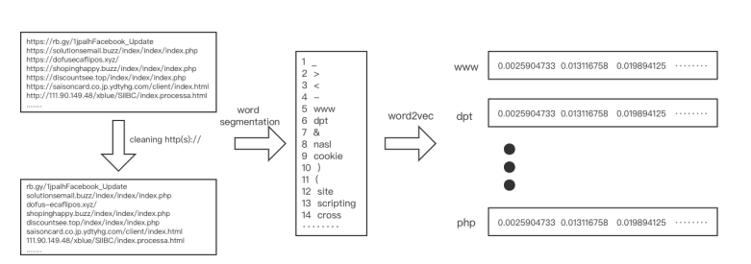
Data pre-processing

Slide 5
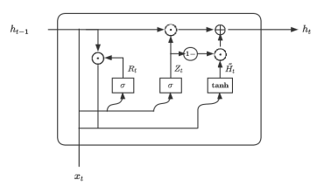
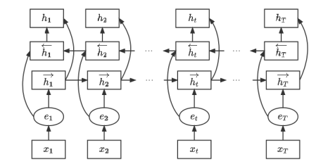
Bi-directional GRU
GRU
Bi-directional GRU

Slide 6
Proposed methodology
Input URL
Word
Segmentation
Word2Vector
Embedding
Bidirectional
GRU
Determine URL’s
Category

Slide 7
Novelty
We are using Bi-directional GRU to train our model.
Better at capturing long-term dependencies: Bidirectional GRU can capture long-term dependencies in both forward and backward directions, whereas GRU and LSTM only capture dependencies in the forward direction. This allows the model to better understand the context of the sequence data and make more accurate predictions.
Improved accuracy
More efficient: Bidirectional GRU is more computationally efficient than LSTM, as it has fewer parameters and operations to compute. This makes it a good choice for real-time applications or devices with limited computing power.
Better at handling noisy data: Bidirectional GRU is less sensitive to noise and outliers in the data than LSTM, as it can use information from both directions to correct errors in the sequence.

Slide 8
Our work:
We have taken a huge dataset of 651,191 URLs, out of which 428103 benign or safe URLs, 96457 defacement URLs, 94111 phishing URLs, and 32520 malware URLs.
After collecting data we have performed data cleaning because the URL protocol is generally http:// or https://, this part of the content has little effect on the identification of malicious URLs. Therefore, this paper conducts data cleaning on URLs containing http:// and https:// in the experimental data set to remove redundant information to reduce the waste of features.
Then we perform word segmentation followed by word2vector to get fixed size word vector
After pre-processing of data we split dataset into 80:20 ratio for training and testing purpose, then we apply GRU model to train the model.
In this experiment we have used adam optimizer with 0.001 learning rate and for 10 epochs with drop out 0.2 .
After performing 10 epochs we are getting more than 98% accuracy for our test data, which performs batter than LSTM,CNN based model.

Slide 9
Results
results of various ML model
Results of Bidirectional-GRU:
Accuracy = 98.3 for 10 epochs with learnig rate of 0.001 and we have used adam optimizer .
MODEL | ACCURACY
Decision Tree Classifier | 0.909282
Random Forest Classifier | 0.914872
AdaBoost Classifier | 0.820077
KNeighbors Classifier | 0.889618
SGD Classifier | 0.804897
Extra Trees Classifier | 0.914626
Gaussian NB | 0.789548

Slide 10
Conclusion
From the experiment it is observed that Bi-GRU model perferms better than all the machine learning model.
We are getting an 98% accuracy on test data which consists of over 130000 urls.
Better at capturing long-term dependencies
Bidirectional GRU can achieve higher accuracy than traditional GRU and LSTM models.
This makes it a good choice for real-time applications or devices with limited computing power.

Slide 11
References
[1] Eunaicy, J.J.C.; Suguna, S. Web attack detection using deep learning models. Mater. Today Proc. 2022, 62, 4806–4813
[2] B. Gogoi, T. Ahmed and A. Dutta, "A Hybrid approach combining blocklists, machine learning and deep learning for detection of malicious URLs," 2022 IEEE India Council International Subsections Conference (INDISCON), Bhubaneswar, India, 2022, pp. 1-6, doi: 10.1109/INDISCON54605.2022.9862909.
[3] Roy, S.S.; Awad, A.I.; Amare, L.A.; Erkihun, M.T.; Anas, M. Multimodel Phishing URL Detection Using LSTM, Bidirectional LSTM, and GRU Models. Future Internet 2022, 14, 340. https://doi.org/ 10.3390/fifi14110340

Slide 12
Thank you

